Slide 1
Analysis of Medical Malpractice Claims
DATA601 Fall 2024
Peter Myers

Slide 2
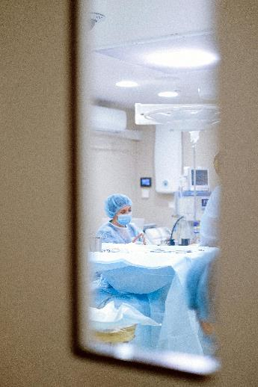
Our Data Set
Medical Malpractice is when there is harm caused by a health care provider due to accident, or negligence.
Medical Malpractice Insurance is insurance carried by a healthcare provider that allows compensation to the injured party in the in case of malpractice.
Our data set contains information regarding the amounts paid by medical malpractice insurance.

Slide 3
Overview of our Data Set
Columns included in our data:
Amount - Amount of the claim payment in dollars
Severity - The severity rating of damage to the patient, from 1 (emotional trauma) to 9 (death)
Age - Age of the claimant in years
Private Attorney - Whether the claimant was represented by a private attorney
Marital Status - Marital status of the claimant (0 (Divorced), 1 (Single), 2 (Married), 3 (Widowed), 4 (Unknown))
Specialty - Specialty of the physician involved in the lawsuit
Insurance - Type of medical insurance carried by the patient
Gender - Patient Gender

Slide 4
Data Cleaning Challenges
Imbalanced Data:
Gender: Female Claimants were over-represented (60% of total)
Private Attorney: Claimants with Private Attorneys were over-represented (66%)
Insurance: Private Insurance represented ~50% of the data, remaining 4 groups represented the other half. 2nd largest Insurance group was Unknown, accounting for ~33% of the data
Categorical Data as Numeric
The Marital Status column contained a numeric value from 0 to 4 for each category. We re-mapped our dataset to contain the name of the respective group.

Slide 5
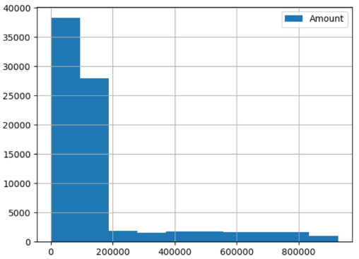
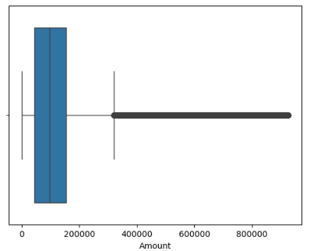
Major Observations
Amount
Data was right-skewed and appeared to have a strong cut-off near $200,000
Many outliers according to boxplot
Weak correlation among features and amount. The strongest predictor was Severity with an R-value of .34

Slide 6
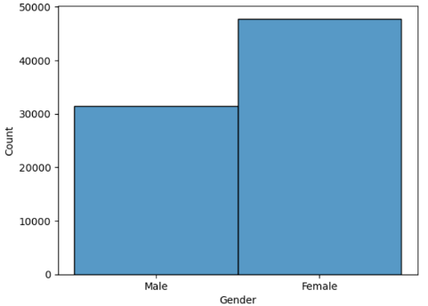
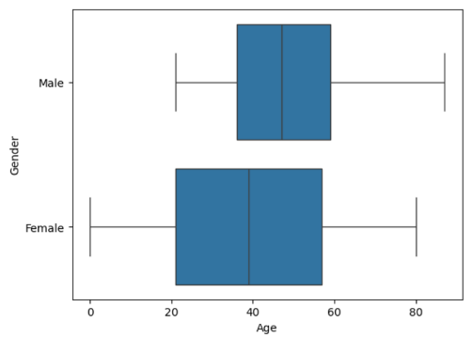
Major Observations
Gender
Unbalanced towards female claimants
Age distribution was not even between male and female claimants
Missing claim data for male claimants under the age of 21

Slide 7
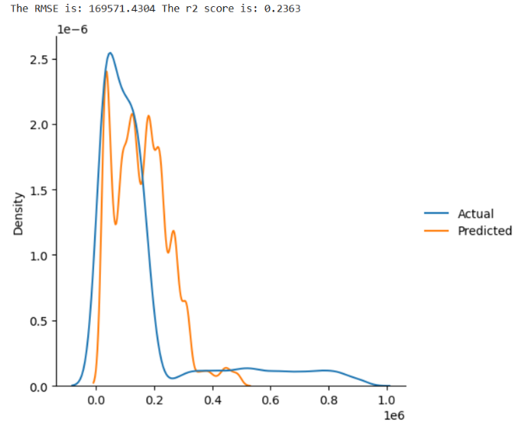
Major Observations
Predictive Capacity
Linear Regressor with 4 top features trained to predict Amount
RMSE : $169,571.43
R-Squared: .2363
Due to weak correlation and skewed distribution of the effectiveness of our model was poor.

Slide 8
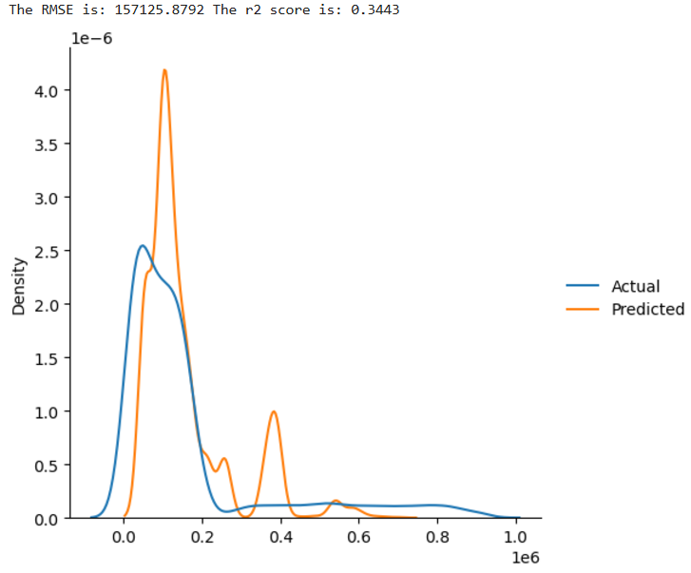
Major Observations
Predictive Capacity
Decision Tree Regressor with 4 top features trained to predict Amount
RMSE : $157,125.88
R-Squared: .3443
Predictive ability improved slightly compared to the Linear Regressor, but overall, still poor.

Slide 9
Conclusions
Data quality
Data balance could be improved
Missing data from young male claimants
More robust measurement of Severity
Was measured on a scale from 1 to 9. Unclear how numbers were collected. If they were self-reported from claimants, could be unreliable.
Predictive Capacity was poor
Better predictions with features more closely related to Amount
High count of ‘Unknown’ values in Insurance and Marital Status columns.
Areas for Further Exploration
Further pre-processing of data before modelling using methods to address data imbalance issues.

